Slide 1
Prediction of Insurance Premium
By Krishna shinde
(ML Engineer)
~ Rigved Sarougi

Slide 2
Project Introduction
Insurance premium is an amount of money a person or business pays for an insurance policy that covers health, vehicle, home, life insurances etc. The insurer provides coverage for claims made against the policy. Premiums are paid either quarterly, half-yearly or yearly depending upon the terms and conditions.
If we talk about health insurance, there are various factors on which the premium amount is dependent on. The premium amount might depending upon these factors like age ,type of disease ,Body Mass Index etc.
Problem Statement
our goal is to forecast insurance charges . insurance Premium is based on different variables. as a result, insurance fees are continuous values. the regression is the best choice available to fulfill our needs.
Also to identify features are important while doing the predictions

Slide 3
Data Source-Describe the data
This data set is provided by NIIT . It contains 1338 samples and 8 features.
we use multiple linear regression in this analysis since there are many independent variables used to calculate the dependent(target) variable hence .
S.No | Feature | Data Type | Description
1 | age | Numeric | Age of the customer
2 | sex | Categorical | Gender of the customer
3 | bmi | Numeric | Calculated BMI
4 | classif | Categorical | Health Classification based on the BMI value
5 | children | Numeric | Number of children
6 | smoker | Categorical | If the customer smokes or not
7 | region | Categorical | Current residential place
8 | Charges (dependent) | Numeric | Premium amount to be paid

Slide 4
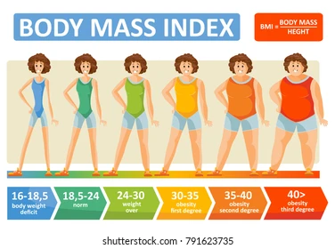
Body mass index (BMI) is a measure of body fat based on height and weight that applies to adult men and women.
BMI | Nutritional status
Below 18.5 | Underweight
18.5–24.9 | Normal weight
25.0–29.9 | Pre-obesity
30.0–34.9 | Obesity class I
35.0–39.9 | Obesity class II
Above 40 | Obesity class III

Slide 5
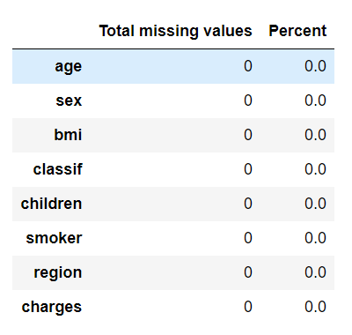
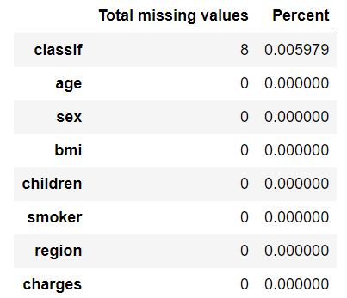

Data Treatment
Null values Before Treatment
Null values After Treatment
Duplicate row

Slide 6
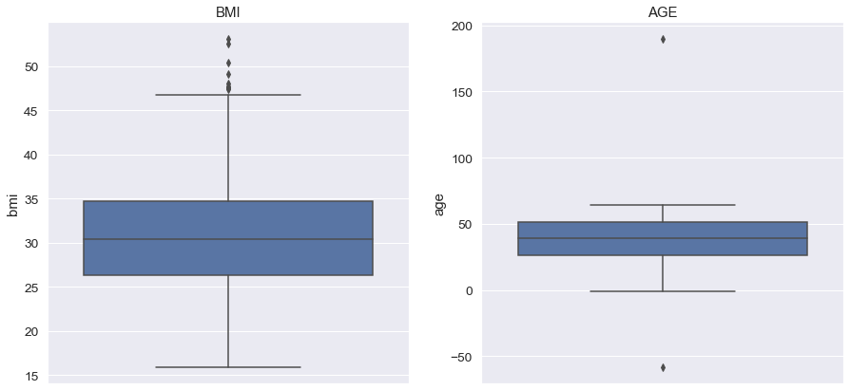
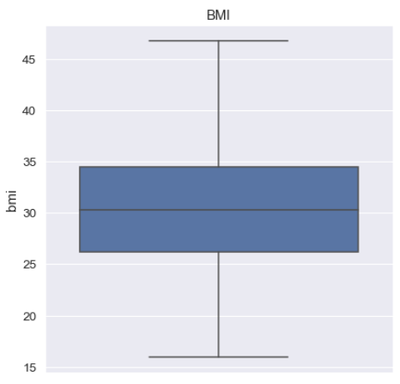
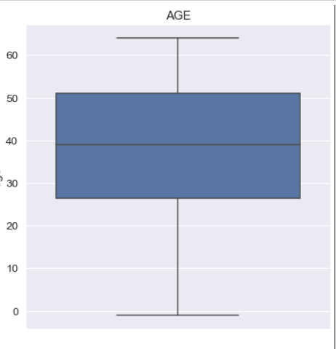
Data Treatment
Box-plot Before outliers treatment
Box-plot after outliers treatment

Slide 7
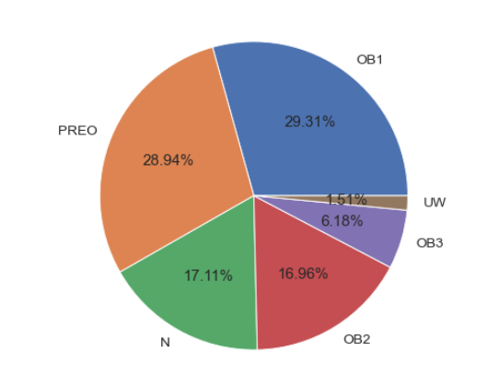
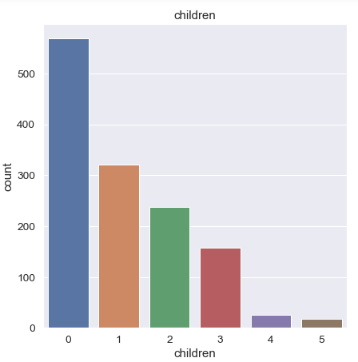
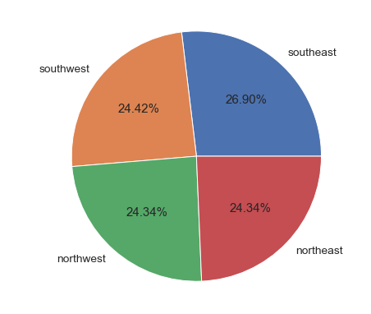
Exploratory data analysis(EDA) --univariate
0 or 1 children
Interpretation 1: around 60 % population having BMI between 25-35 which means they are not normal and falls under the category of pre-obesity and obesity 1 type
Interpretation 2:around 43 % population have no children and 24 % have 1 child.
Interpretation 3: density are equally distributed among all the regions.

Slide 8
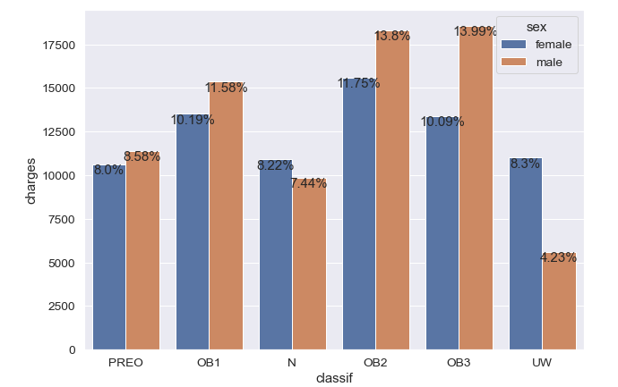
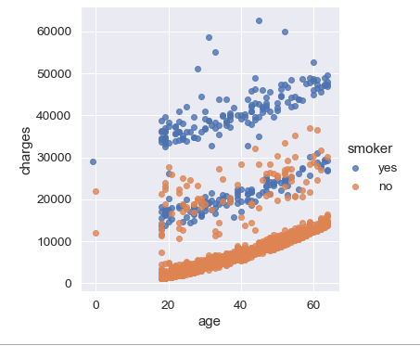
Exploratory data analysis(EDA) –bivariate and Multivariate
OB2 and OB3
Smoker
interpretation :OB2 and OB3 types are having high premium rates as chances of getting stroke in these categories are quit high.Obesity increases the risk of several debilitating, and deadly diseases, including diabetes, heart disease, and some cancers.¶
interpretation : as age increase we can see that it directly impacts the premium charges and also we can observe that smoker are paying high premium compare to non smoker

Slide 9
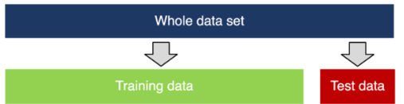
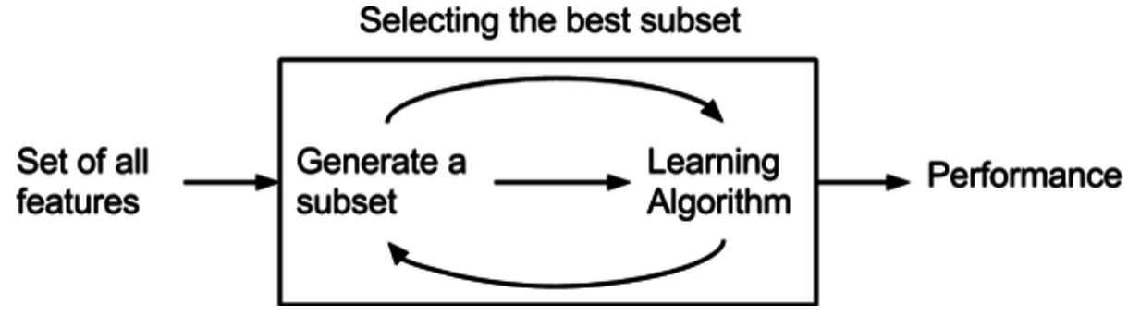
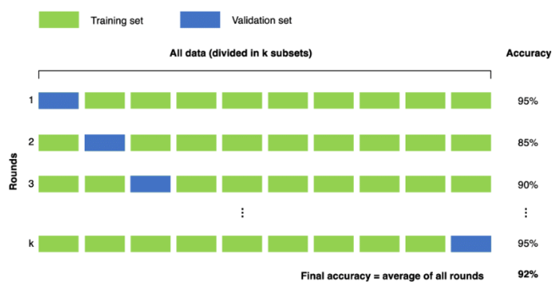
Finding the best parameters For our model
Feature selection
Data splitting into dependent and independent variable and cross validation
1 | age | Age of the customer
2 | bmi | Calculated BMI
3 | classif | Health Classification based on the BMI value
4 | smoker | If the customer smokes or not
1.train_test size =0.2 2.random_state =1

Slide 10
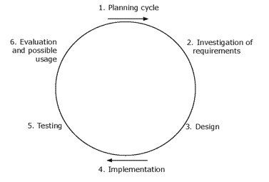
Model TESTING
Planning cycle: -(Choosing the right algorithm. Understanding data)
Investigation of requirements:-feature selection and cross validation
Design:-model building and fitting
Implementation-predicting the values
Testing-comparison of original and predicted values
Evaluation :-evaluating the model using inbuild techniques like MSE and R2 Score

Slide 11
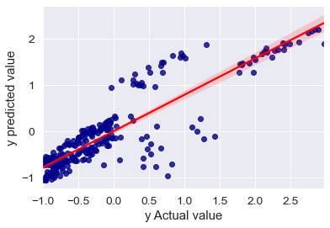
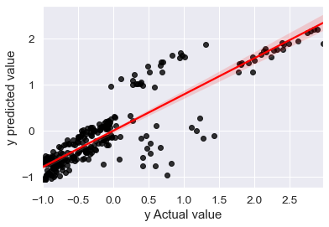
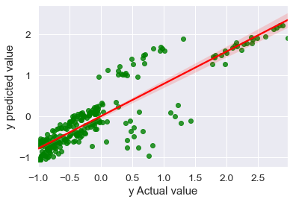
Linear Regression
Ridge Regression
Lasso Regression
MSE = 0.19584133488179334
r2 score is 0.7737073581862388
MSE = 0.195
r2 score is =0.7741
MSE = 0.19632
r2 score is =0.7731

Slide 12
Testing with different algorithms
NAME | MSE | R2 score
Linear Regression | 0.195841 | 0.773707
Ridge Regression | 0.195441 | 0.774170
Lasso Regression | 0.196324 | 0.773149
Random Forest Regressor | 0.164626 | 0.837146
Decision Tree Regressor | 0.316081 | 0.809776
K-Neighbors Regressor | 0.242087 | 0.899072
Selected model
Final conclusion
We can conclude from the above table that r2 score is highest in K-nearest Neighbor but it can lead to problem of overfitting (high variance) to avoid this condition we are choosing Random Forest model for this dataset because of Low variance low bias .

Slide 13
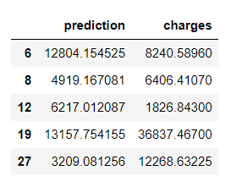
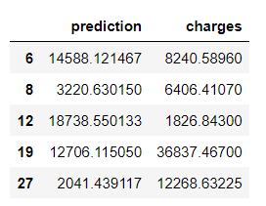
Comparison of both the models
Random Forest Regressor
KNeighborsRegressor
Observation
We can also relate from here that R2 score of KNeighborsRegressor is high but predicted value is closer to actual value in Random Forest Regressor.
R2 score=0.837146
MSE=0.164
R2_score=0.899072
MSE=0.242

Slide 14
THANK YOU!!

